Slide 1
Respiratory motion modelling
Supervisor: Jamie McClelland
Razvan Valentin Marinescu
Benedetta Biffi
Kevin Tchaka
COMPGV17- Computational Modelling in Biomedical Imaging

Slide 2
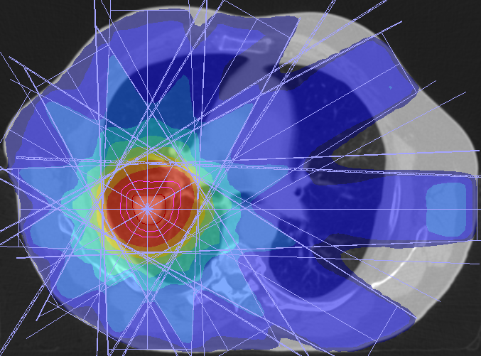
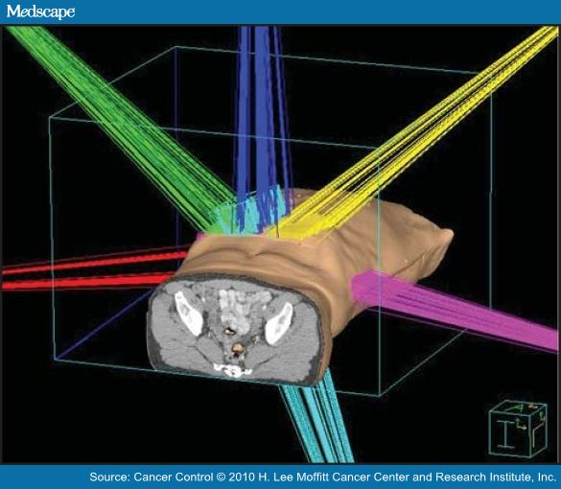
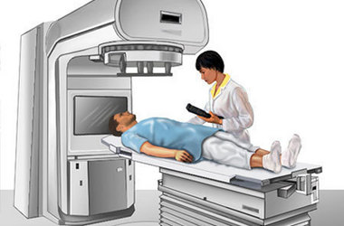
Introduction - Radiotherapy
Radiation Therapy uses ionising radiation to kill malignant cells
It should also spare healthy tissue
<number>

Slide 3
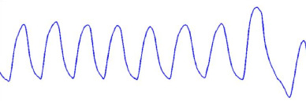
Lung motion
Respiratory motion can make the tumor hard to localise
Hard to perform imaging during radiotherapy
However, surrogate signals are available that model the breath cycle
<number>

Slide 4
Project aim
Model relationship between surrogate signal and motion
Estimate motion from surrogate signal
<number>

Slide 5
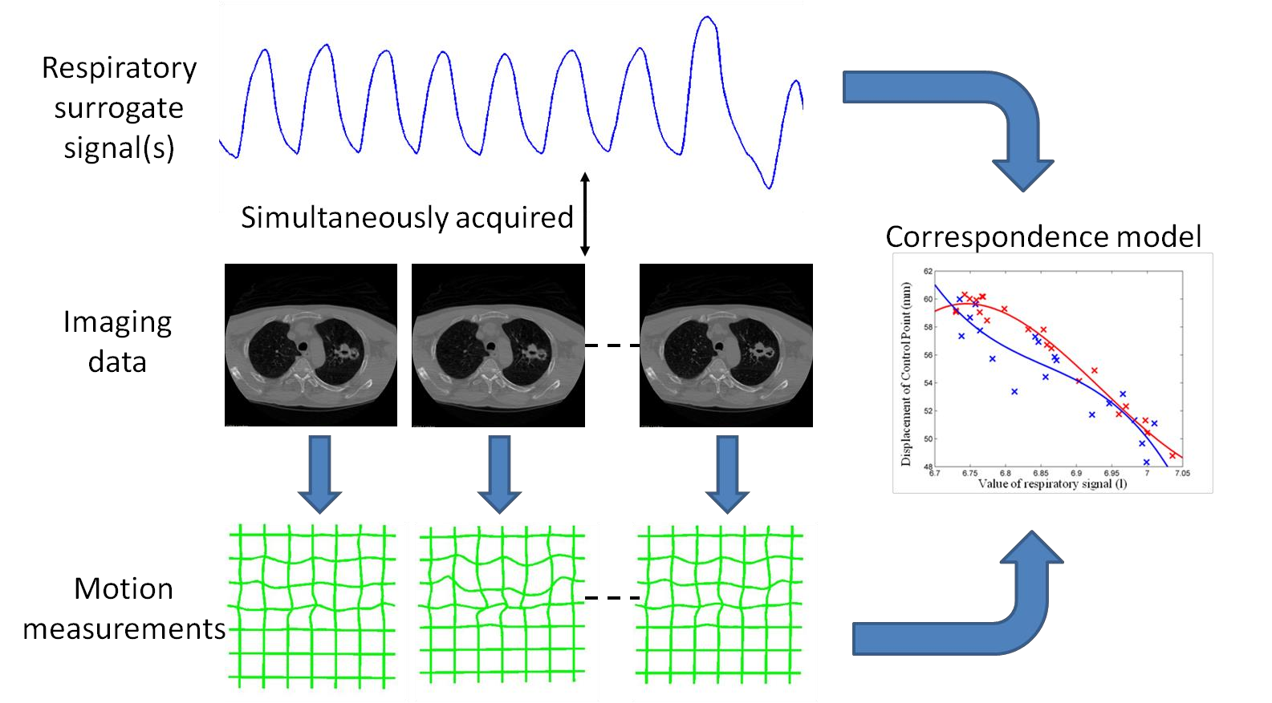
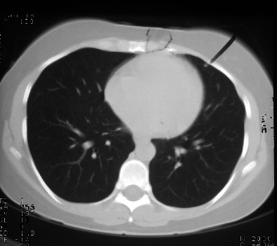
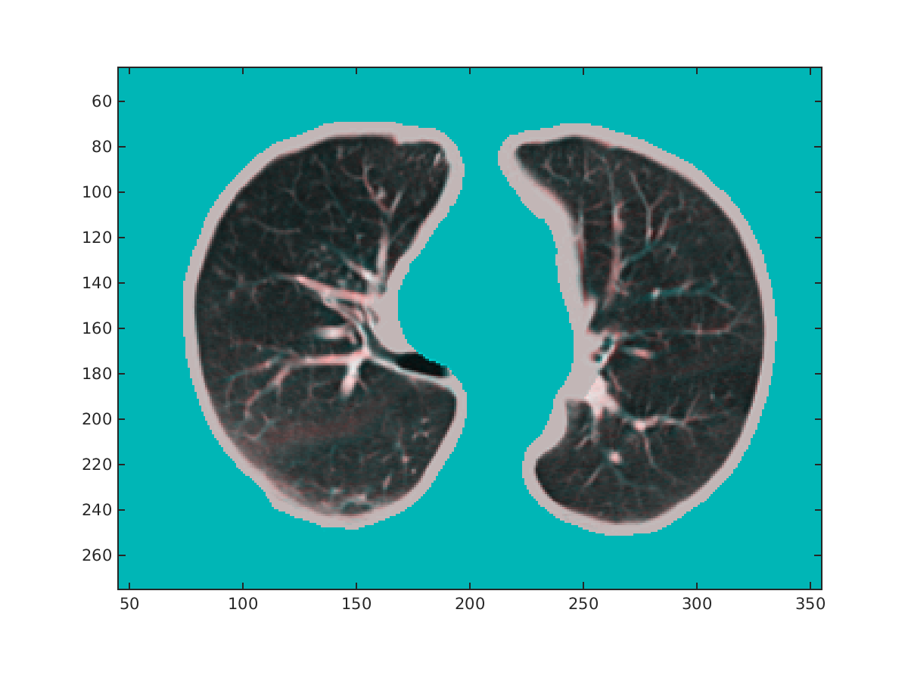
Workflow
Initial end-exhale volume
Registrations
with initial volume
<number>

Slide 6
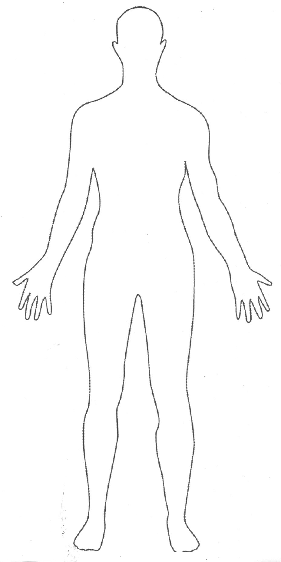
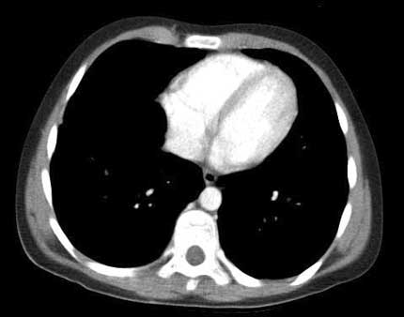
Cine CT dataset
time
<number>

Slide 7
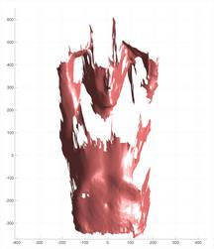
Data used
Cine CT data was acquired at 5 couch positions
40 Cine CT volumes were acquired over 20 seconds at each couch position
12 x 2.4 mm slices for each volume
Respiratory surrogate signal was acquired for each couch position using Vision RT 3D surface data
<number>

Slide 8
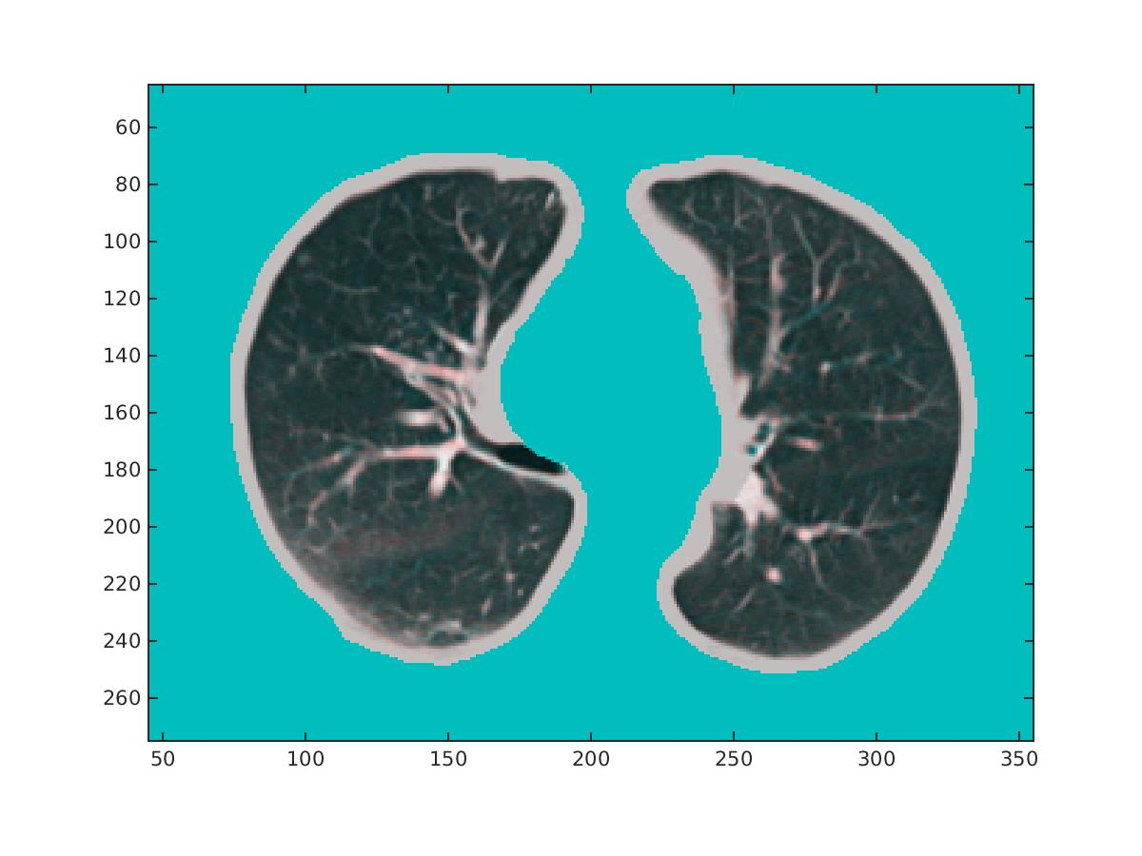
Core task 1: Registration assessment
Good registration
Registration 1
Registration 2
Couch 1, volume 1, slice 66
<number>

Slide 9
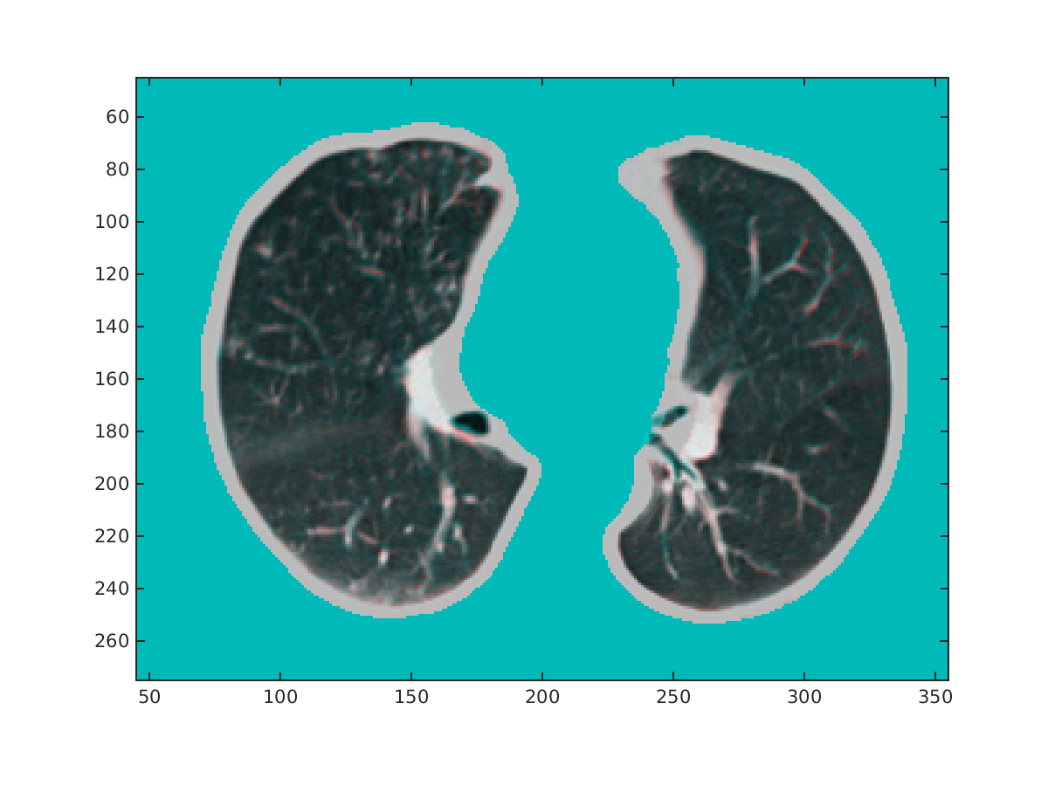

Core task 1: Registration assessment
Good registration
Registration 1
Registration 2
Couch 2, volume 5, slice 60
<number>

Slide 10
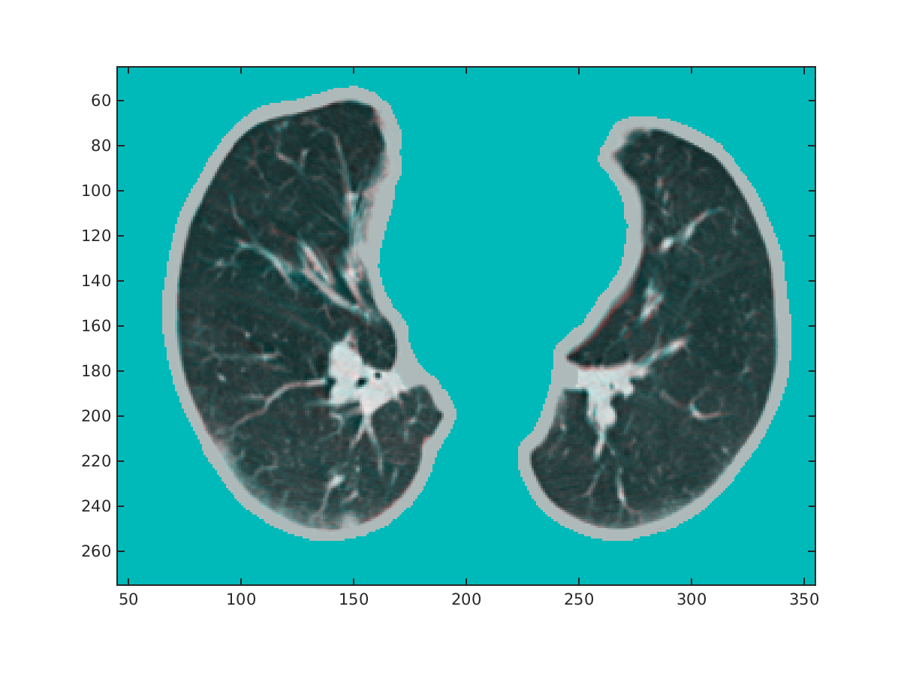

Core task 1: Registration assessment
Good registration
Registration 1
Registration 2
Couch 3, volume 2, slice 49
<number>

Slide 11
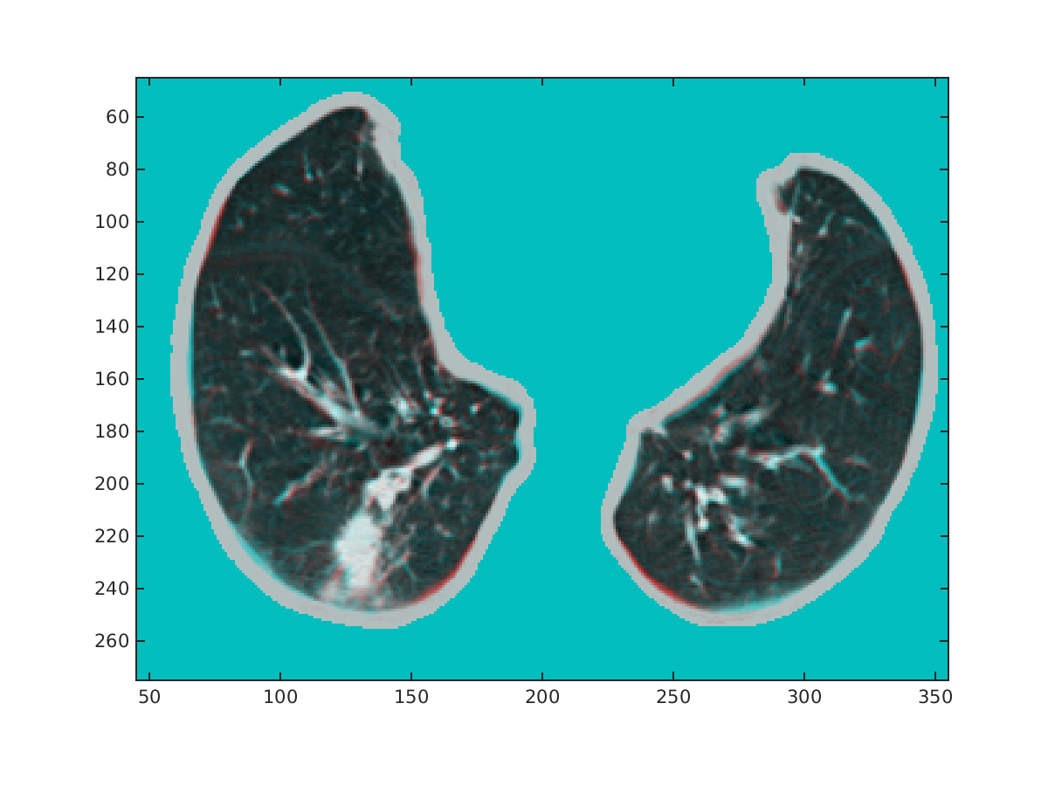
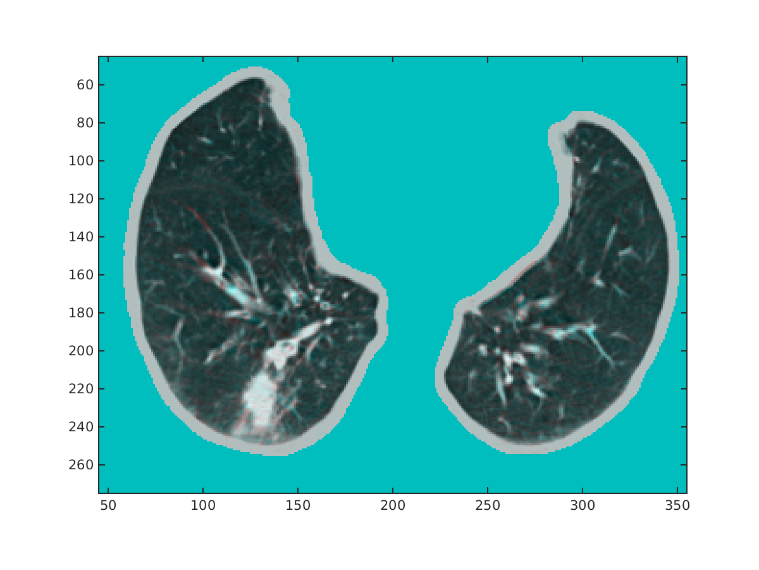
Core task 1: Registration assessment
Good registration
Registration 1
Registration 2
Couch 4, volume 8, slice 37
<number>

Slide 12
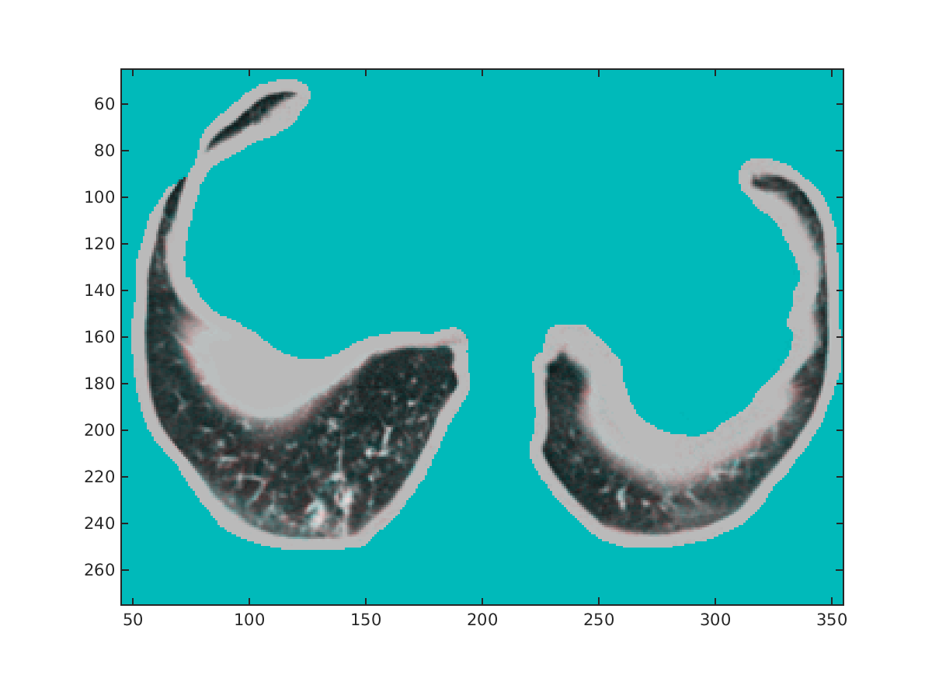
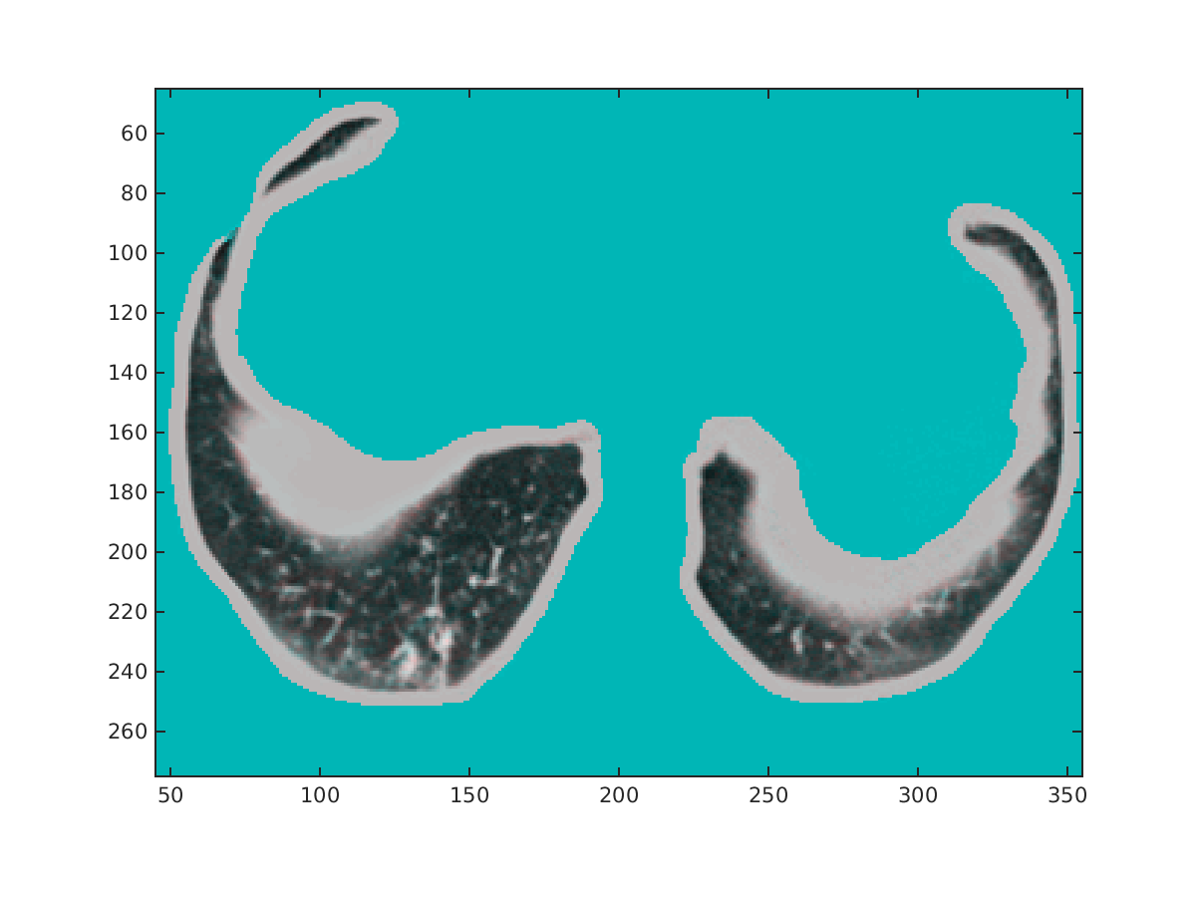
Core task 1: Registration assessment
Good registration, although segmentation was more difficult due to shape
Registration 1
Registration 2
Couch 5, volume 4, slice 25
<number>
Notes:
Is this actually wrong? This is how the upper part of the lungs look like.

Slide 13
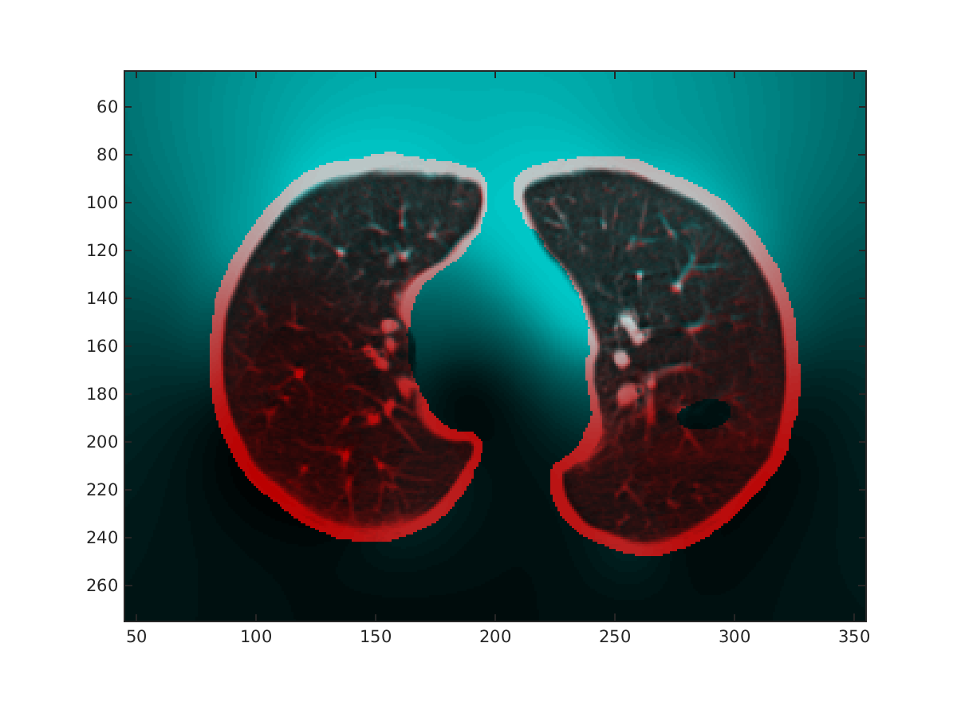
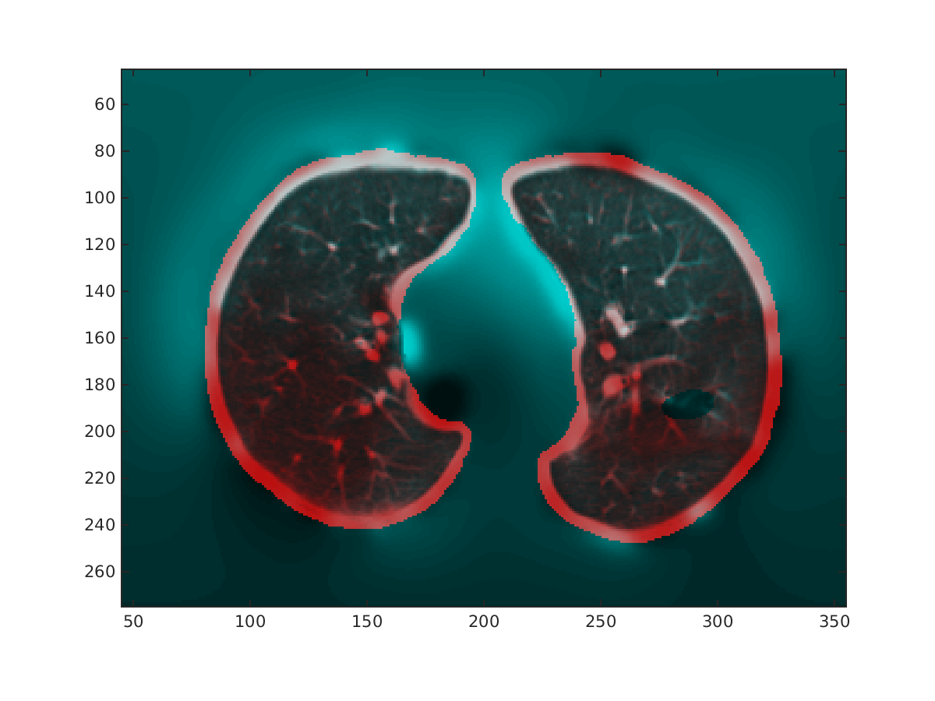
Core task 1: Registration assessment
Bad registrations due to misalignment
Registration 1
Registration 2
Couch 1, volume 6, slice 76
<number>

Slide 14

Core task 1: Registration assessment
Registration videos
Registration 1
Registration 2
Couch 1, all volumes and slices
<number>
Notes:
each video is made from 110 images and has 7.5M

Slide 15
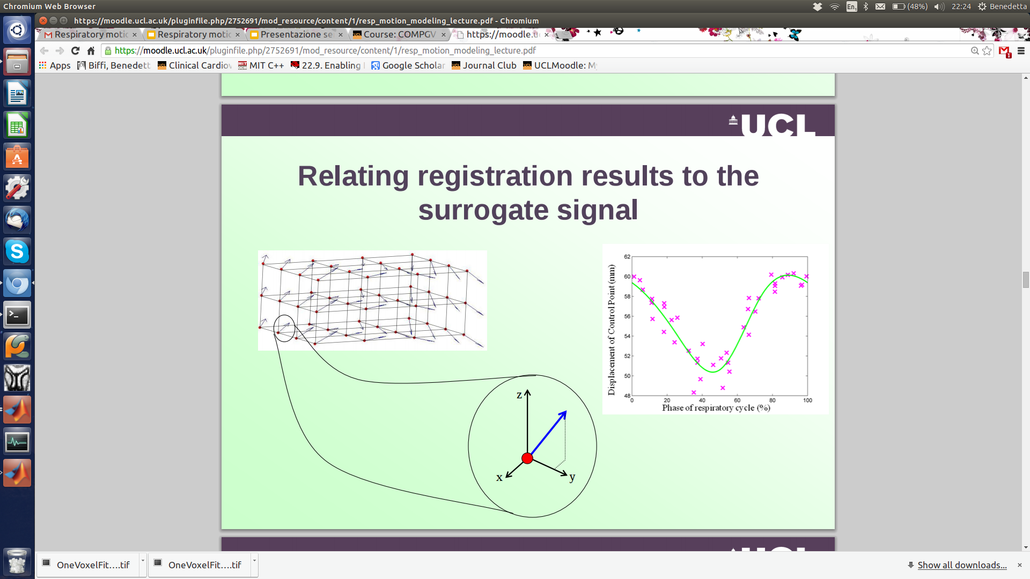
Core task 2: One Voxel Fitting - Data
4DCT registered on CINE CT,
5 couch positions
1 pixel for each position,
z displacement of the CPG
<number>

Slide 16
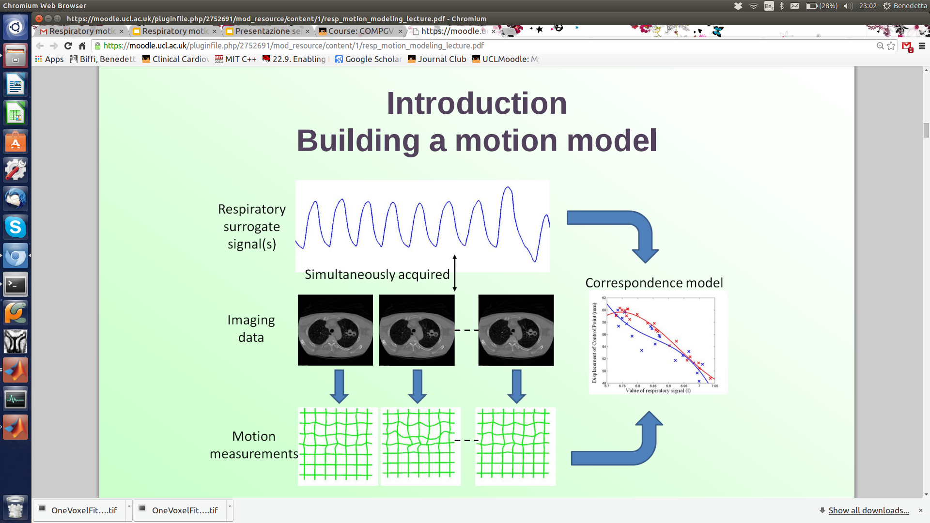
Core task 2: One Voxel Fitting - Data
4DCT registered on CINE CT,
5 couch positions
1 pixel for each position,
z displacement of the CPG
Respiratory
surrogate signal
<number>

Slide 17
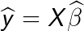
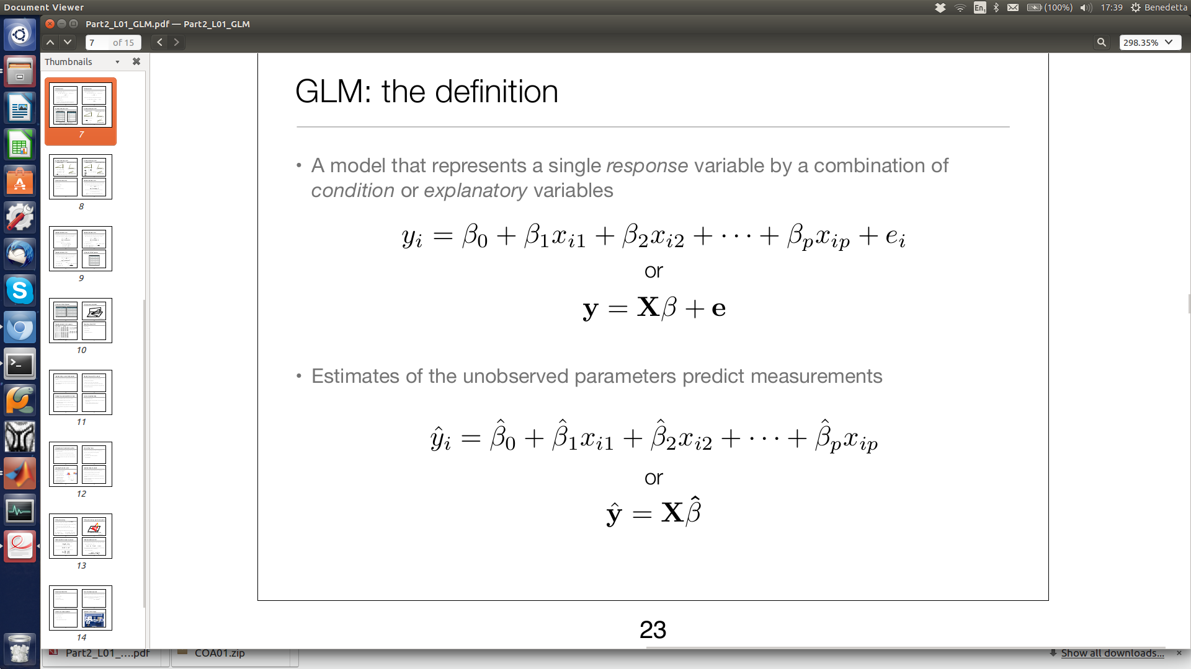
Core task 2: One Voxel Fitting - The models
<number>

Slide 18
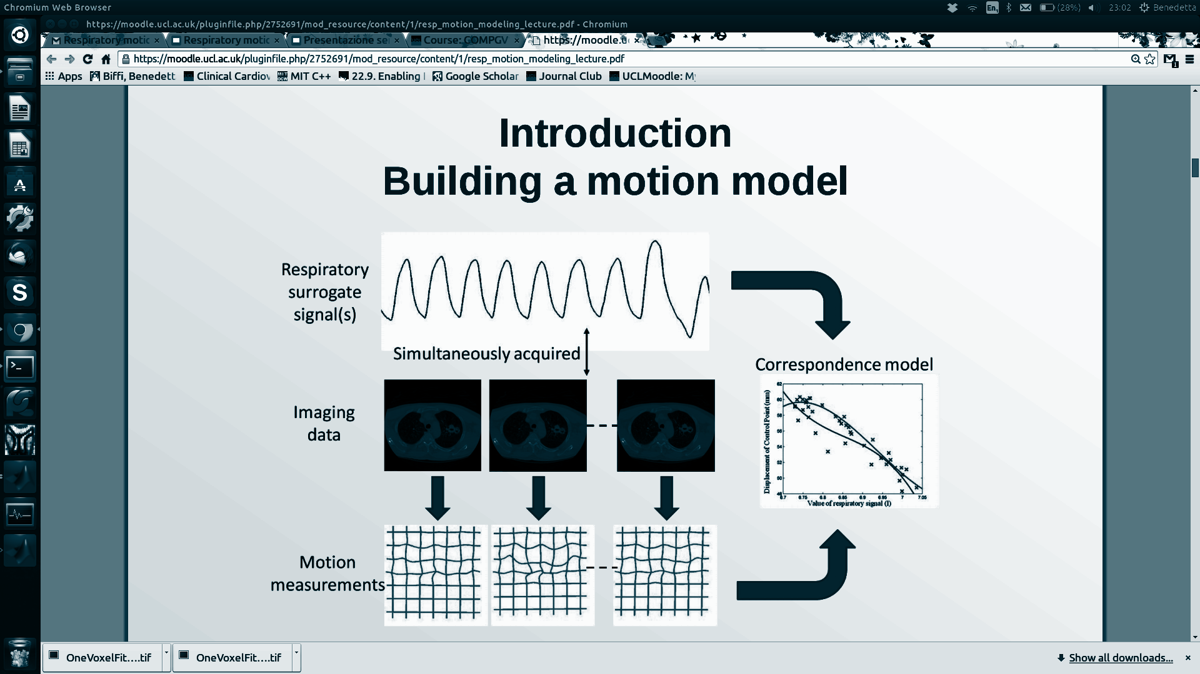
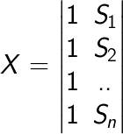
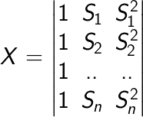
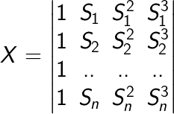
Core task 2: One Voxel Fitting - The models
Design Matrix
Depends on the respiratory surrogate signal
S =
1st order
2nd order
3rd order
<number>

Slide 19
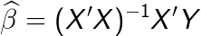
Core task 2: One Voxel Fitting - The models
Estimated model parameters
Depend on the design matrix and the z displacement of the CPG
Design Matrix
Depends on the respiratory surrogate signal
S =
1st order
2nd order
3rd order
<number>

Slide 20
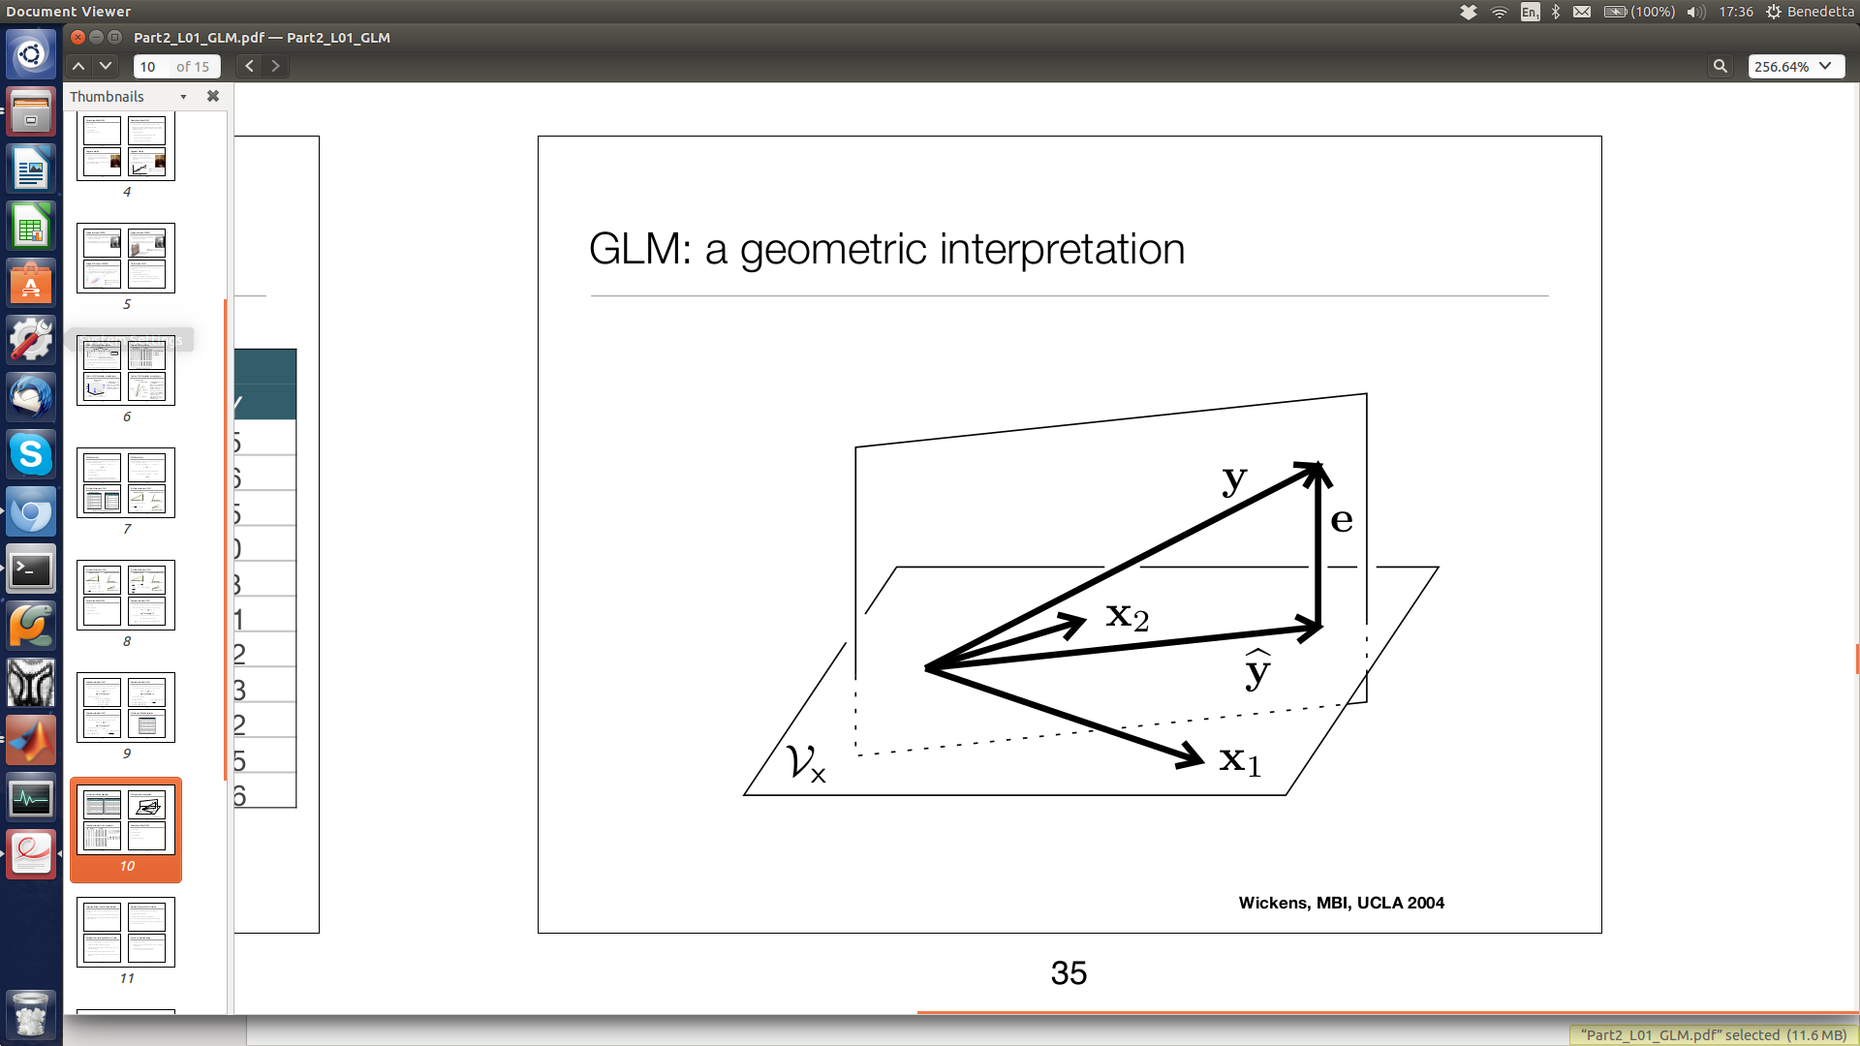
Core task 2: One Voxel Fitting - The models
Estimated z displacement of the CPG
Estimated model parameters
Depend on the design matrix and the z displacement of the CPG
Design Matrix
Depends on the respiratory surrogate signal
S =
1st order
2nd order
3rd order
<number>

Slide 21
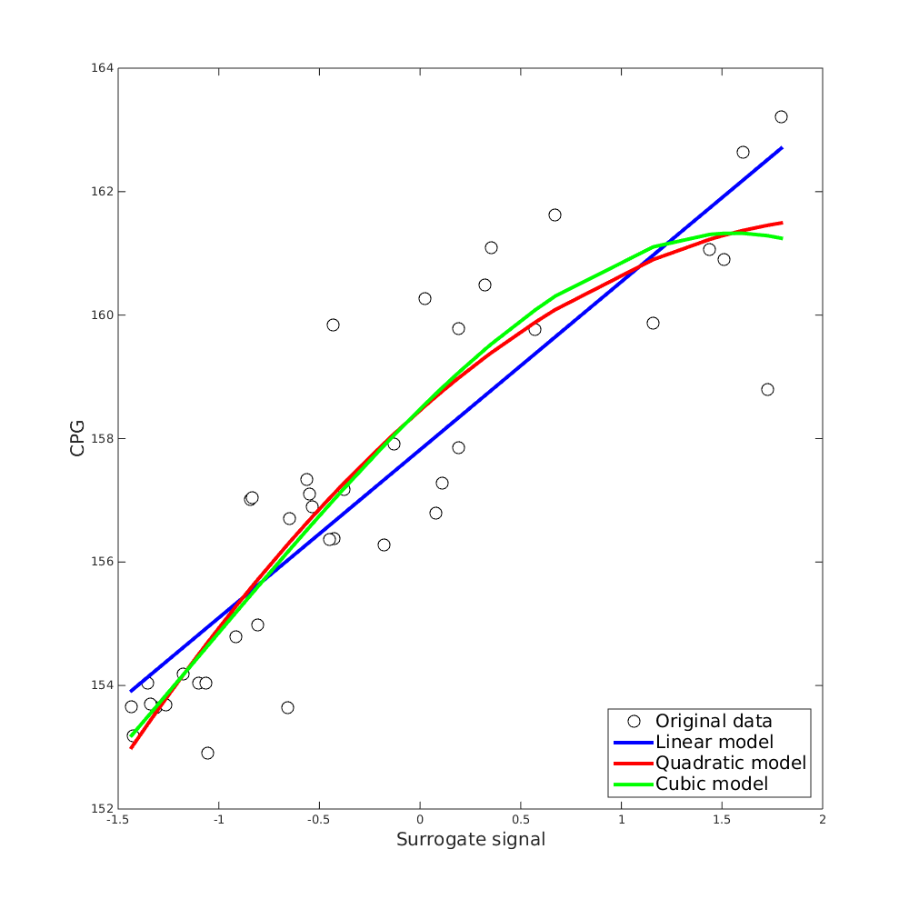
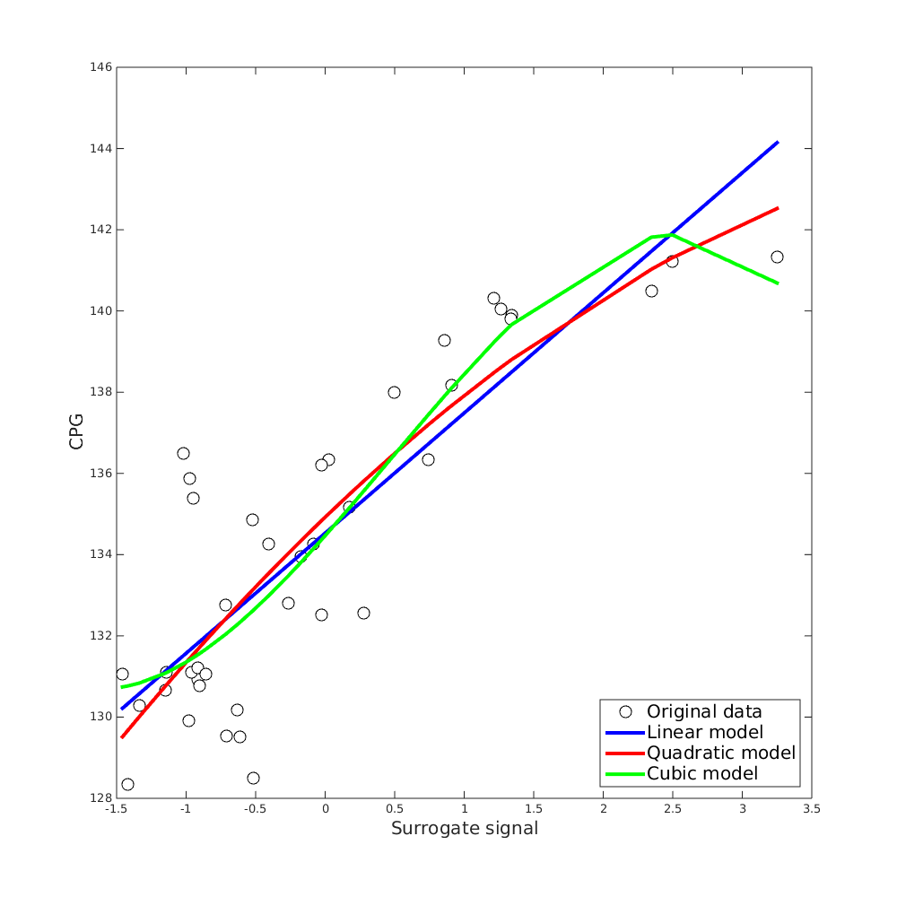
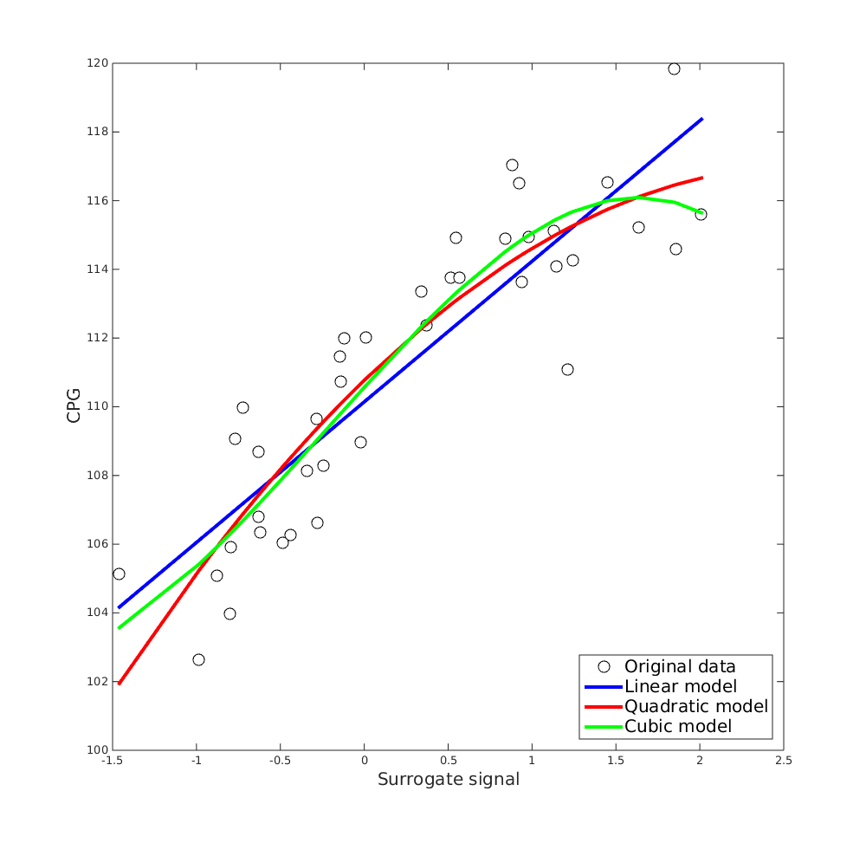
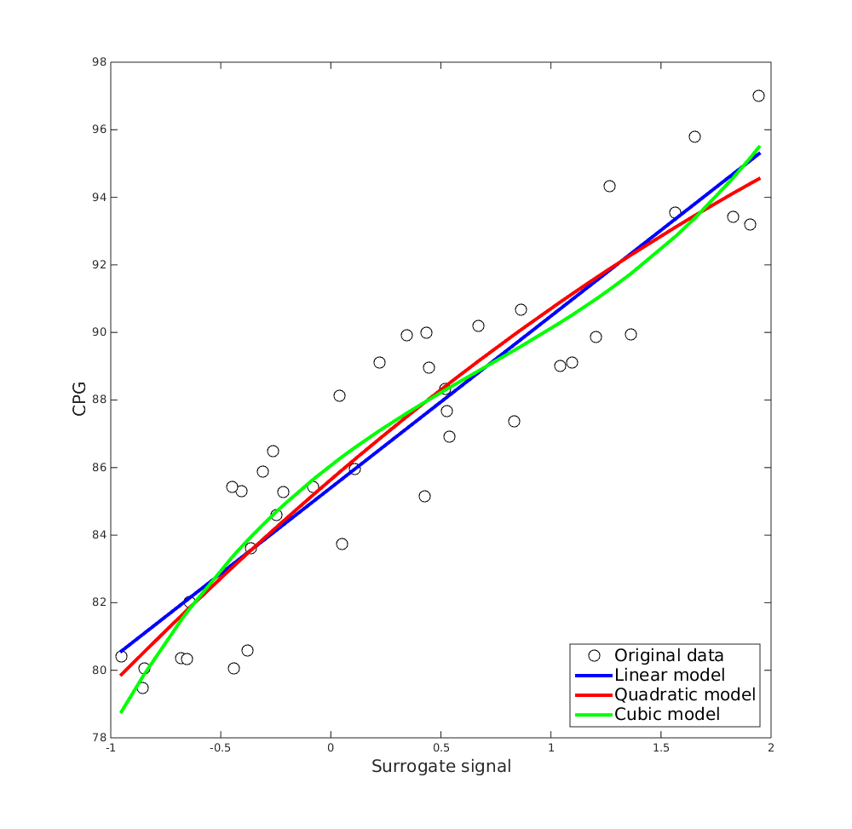
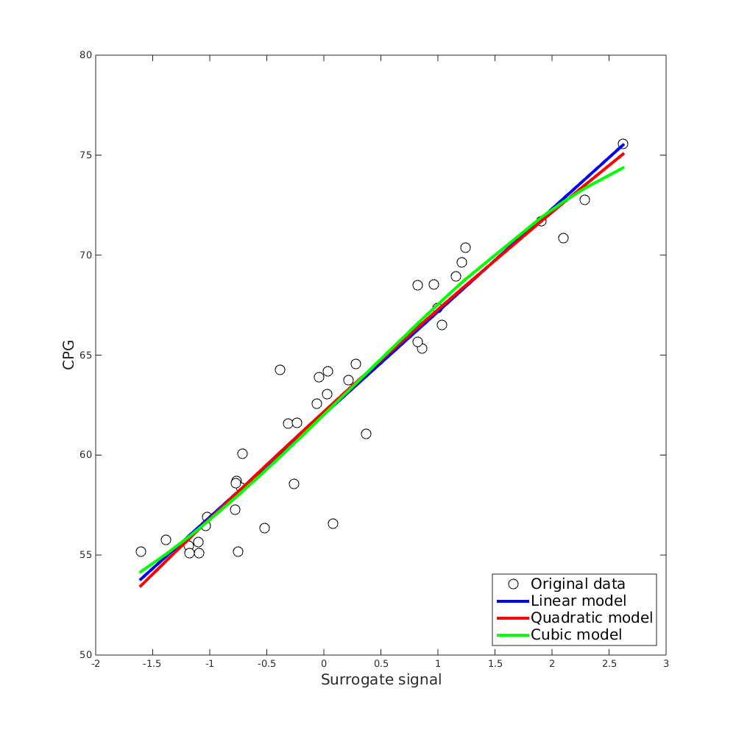
Core task 2: One Voxel Fitting - Results
<number>

Slide 22
Core task 2: One Voxel Fitting - Results
Couch position 1
<number>

Slide 23
Core task 2: One Voxel Fitting - Results
Couch position 2
<number>

Slide 24
Core task 2: One Voxel Fitting - Results
Couch position 3
<number>

Slide 25
Core task 2: One Voxel Fitting - Results
Couch position 4
<number>

Slide 26
Core task 2: One Voxel Fitting - Results
Couch position 5
<number>

Slide 27
Core task 5: Uncertainty - Methods
Parametric bootstrap
Residual bootstrap
Wild bootstrap
MCMC
Parameter distribution
2σ range
95% confidence interval
<number>
Notes:
difference among bootstrapping: the way they do the resampling
parametric: assume gaussian error
residual: they use the residuals computed on the previous iteration, but randomly reassigned to each value
wild: residuals multiplied by N(0,1) (each of the data can be affected in a different way..)
MCMC: it perturbs the parameters (and not the data!!!) and finds the likelihood of the data, given the model probability(data|model)

Slide 28
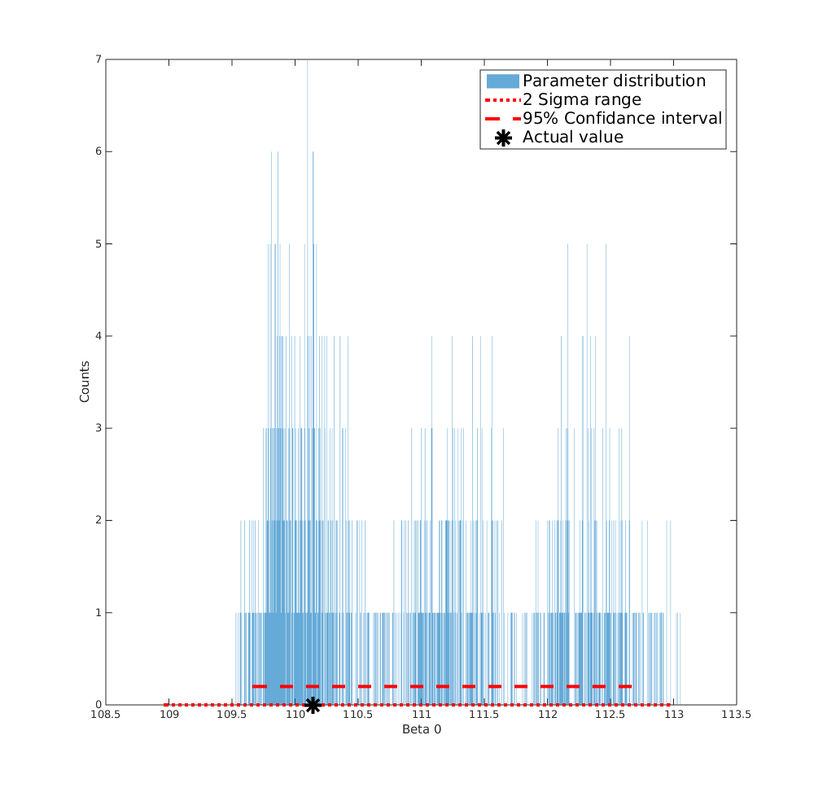
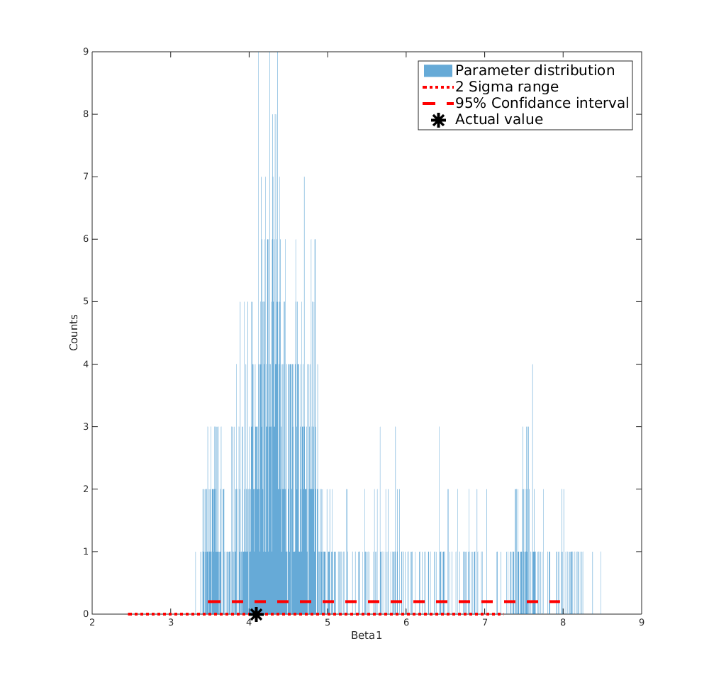
Core task 5: Uncertainty - Bootstrapping
Parametric Bootstrapping on linear model coefficients
Couch position 3
<number>

Slide 29
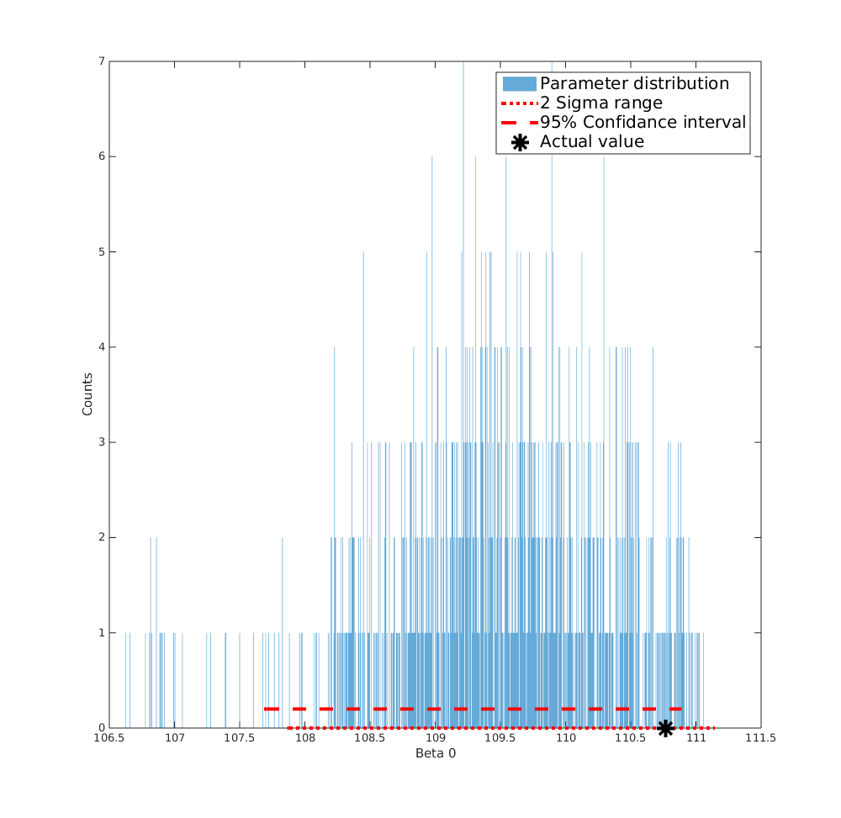
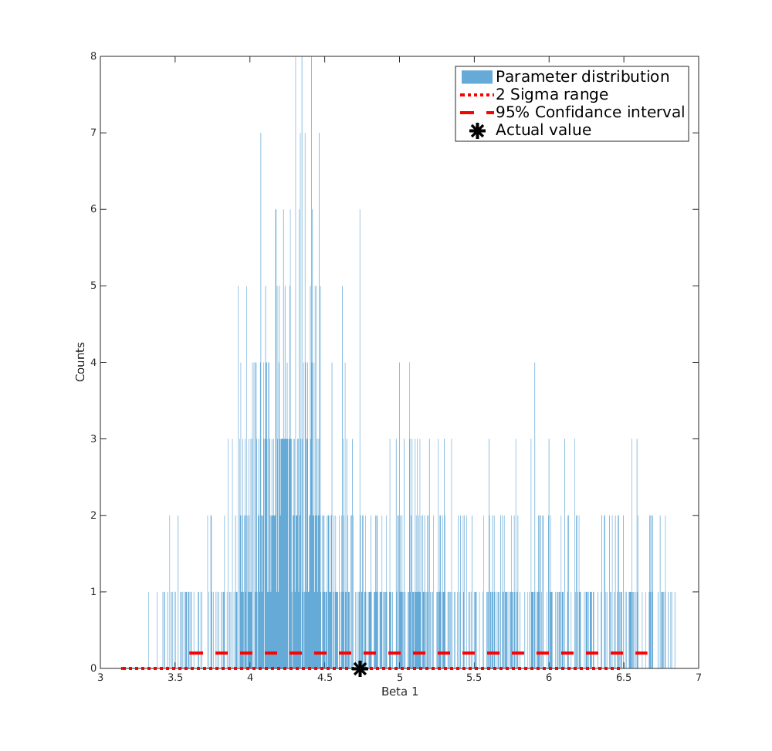
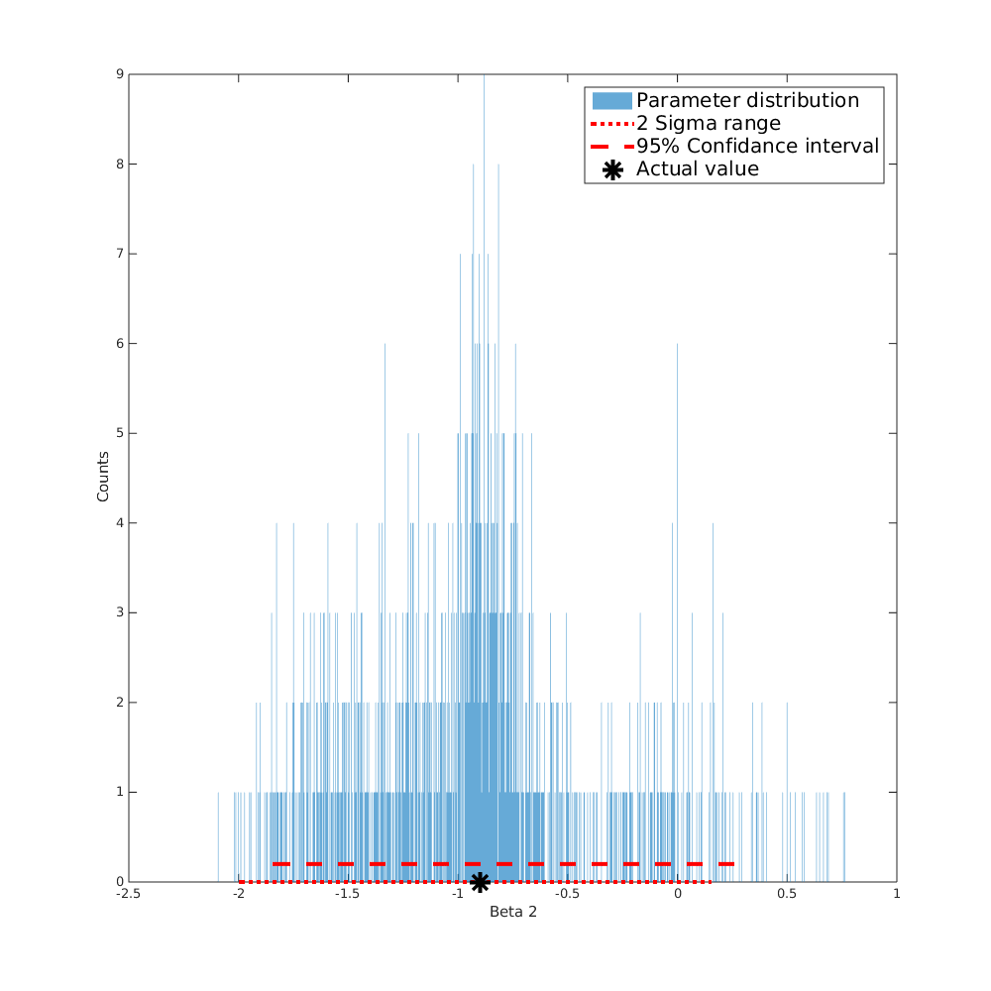
Core task 5: Uncertainty - Bootstrapping
Parametric Bootstrapping on quadratic model coefficients
Couch position 3
<number>

Slide 30
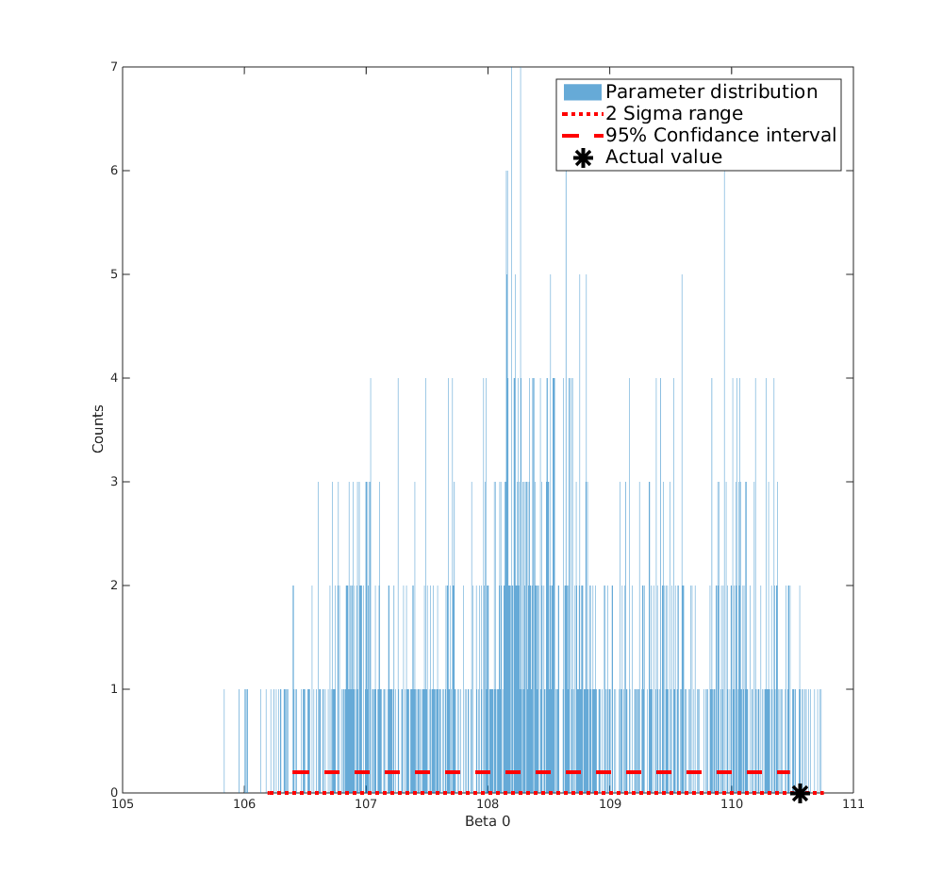
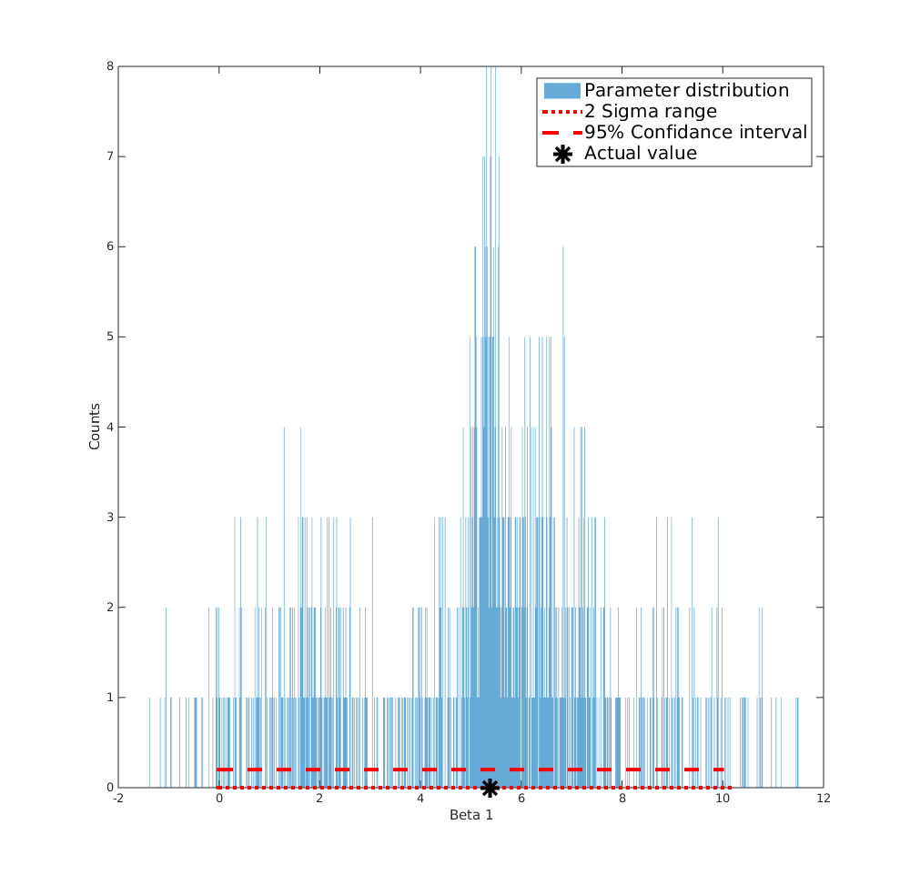
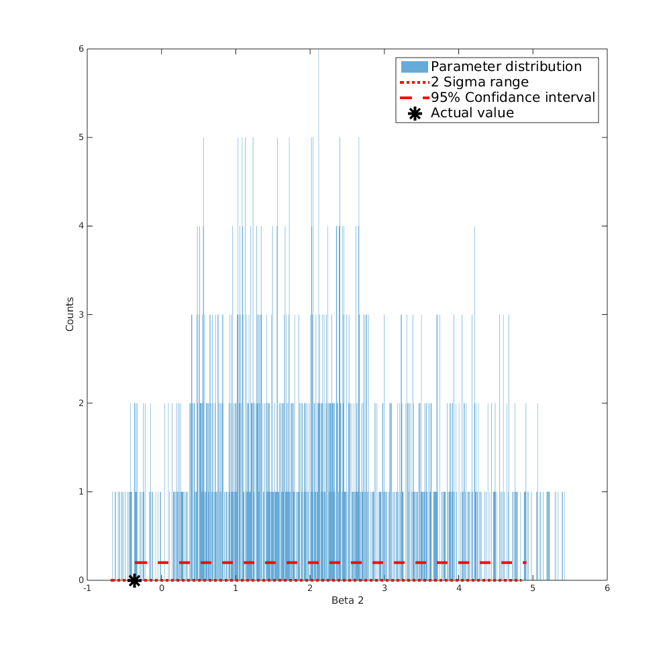
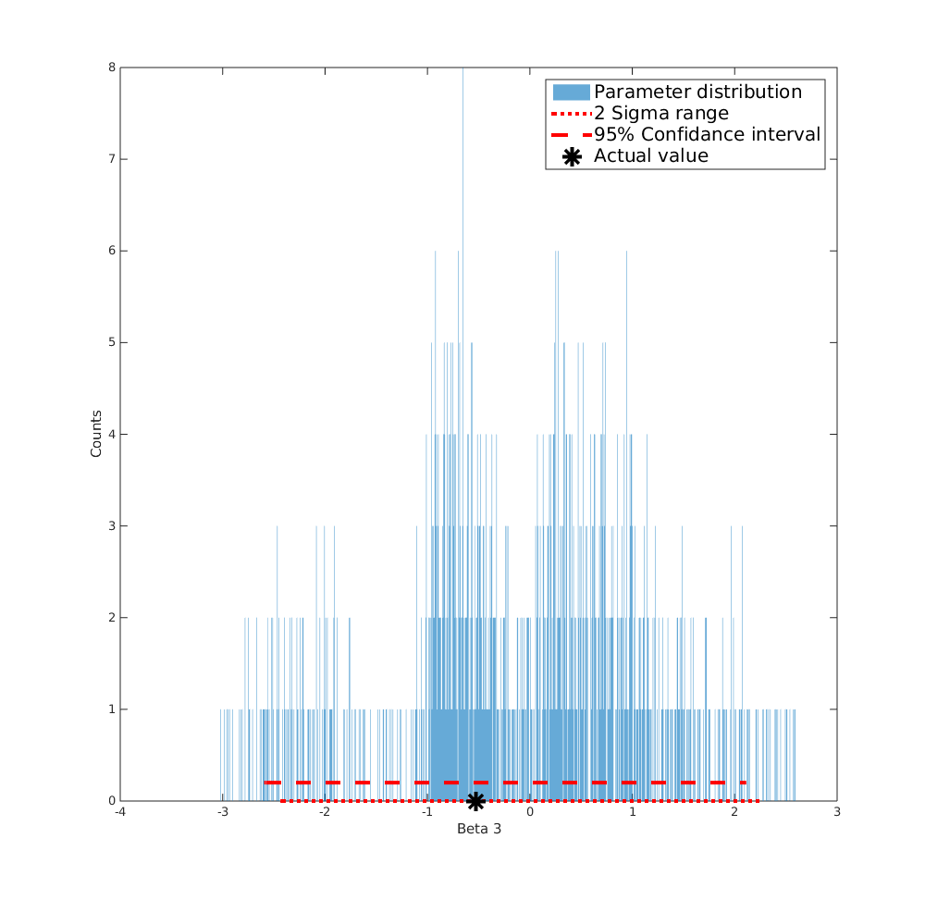
Core task 5: Uncertainty - Bootstrapping
Parametric Bootstrapping on cubic model coefficients
Couch position 3
<number>

Slide 31
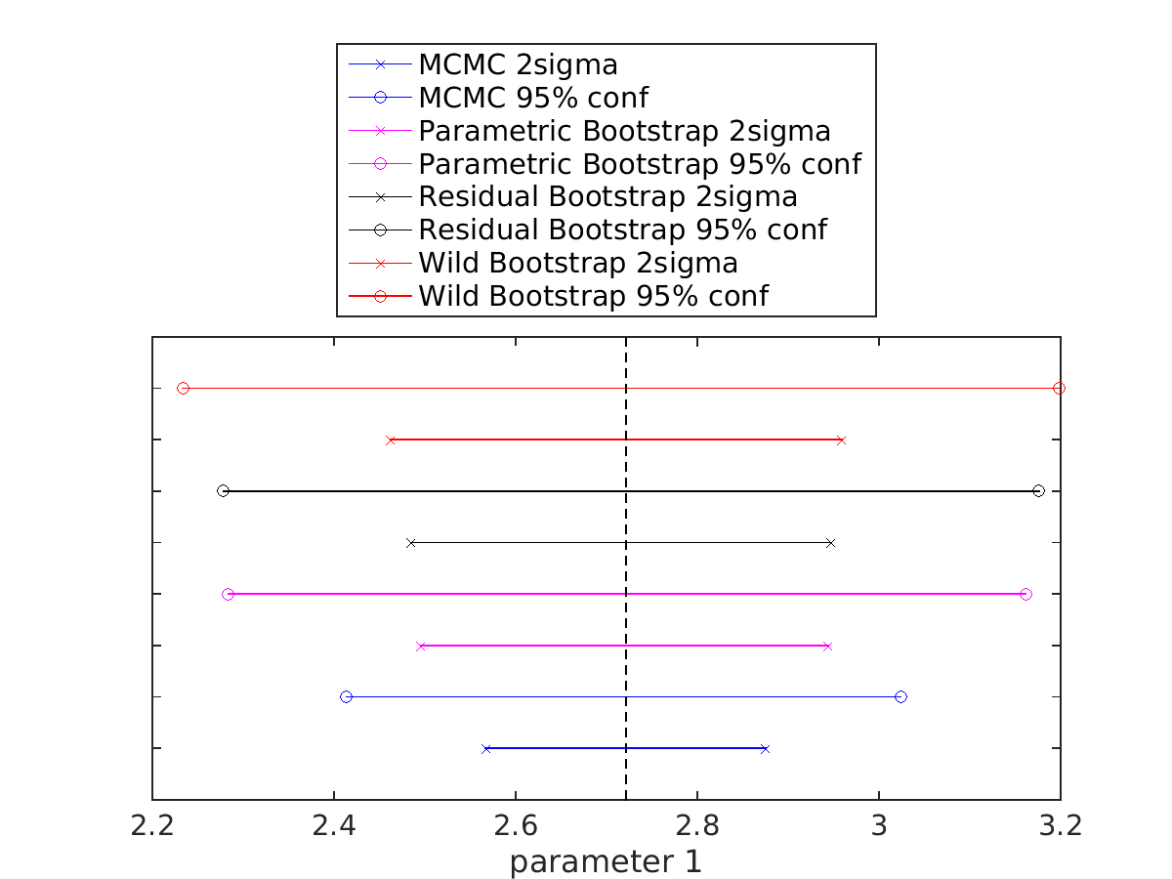
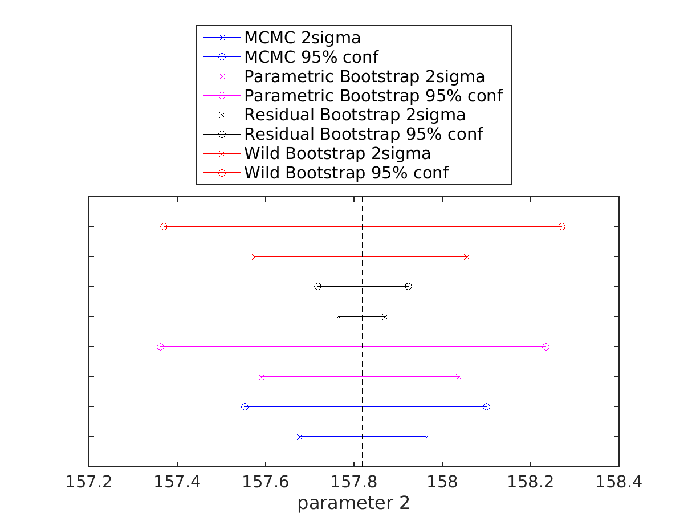
Core task 5: Uncertainty - Different models
Confidence intervals on linear model coefficients
Couch position 5
<number>

Slide 32
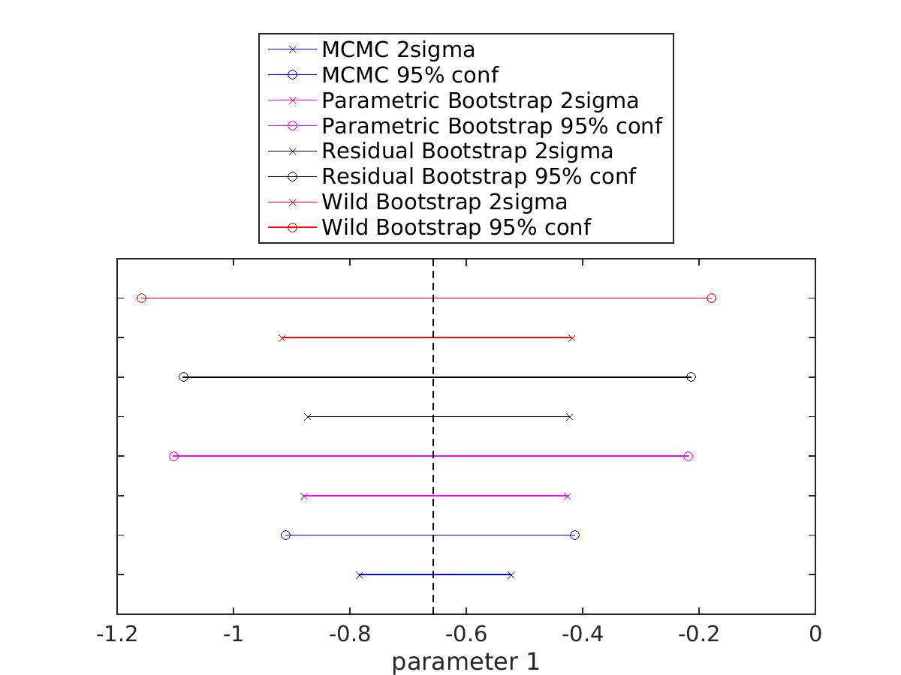
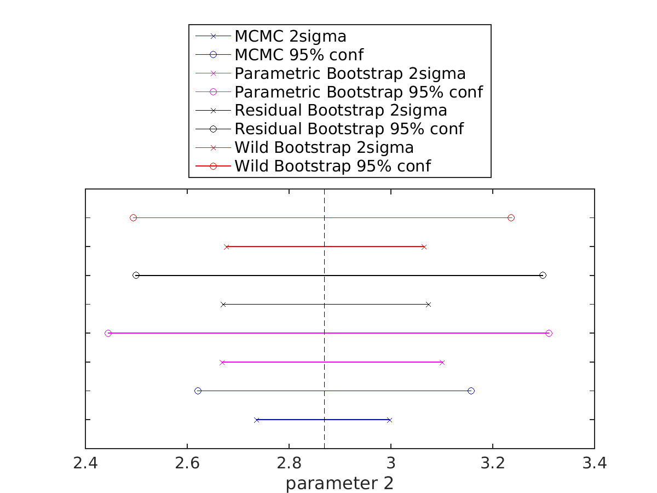

Core task 5: Uncertainty - Different models
Confidence intervals on quadratic model coefficients
Couch position 5
<number>

Slide 33
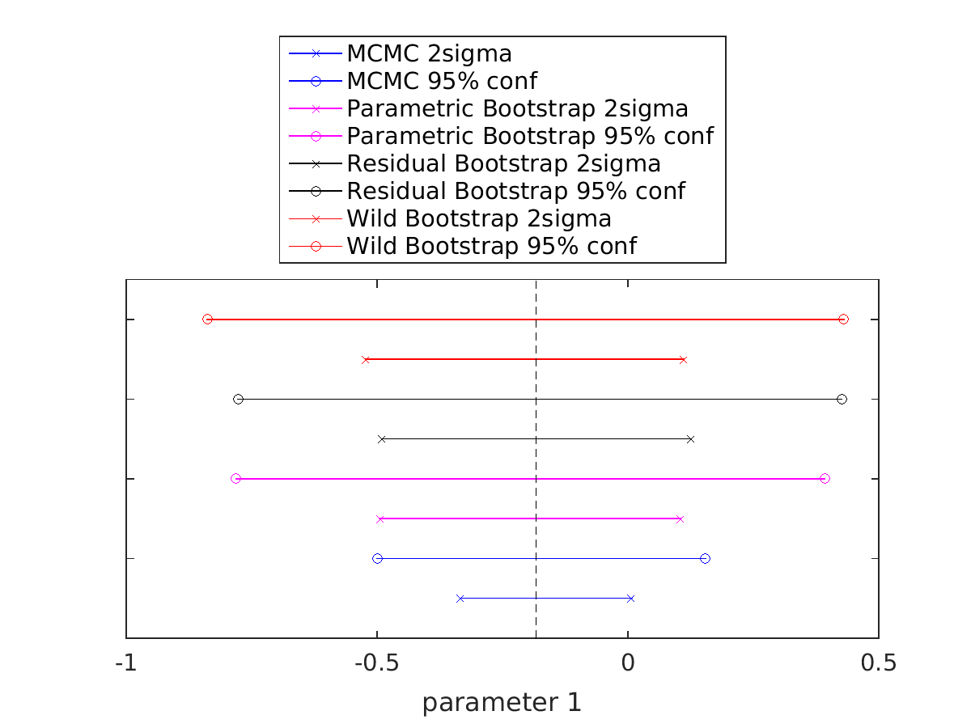
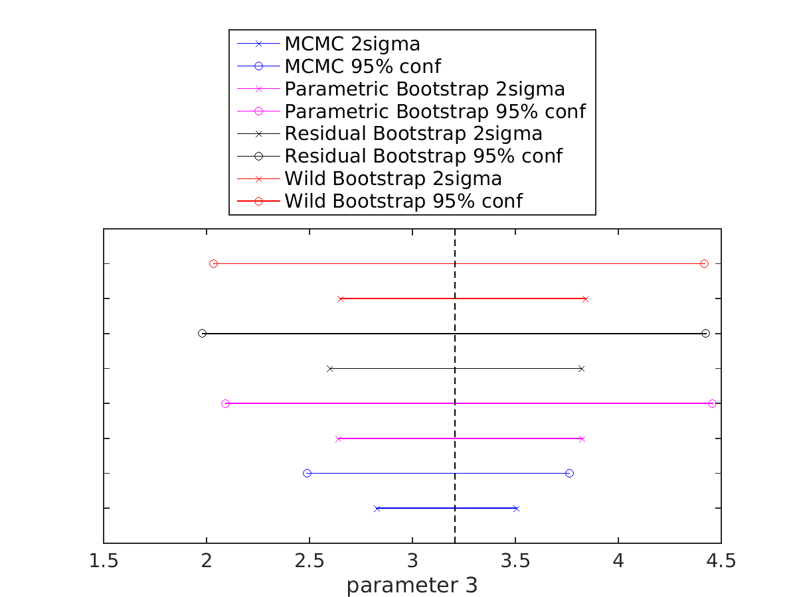
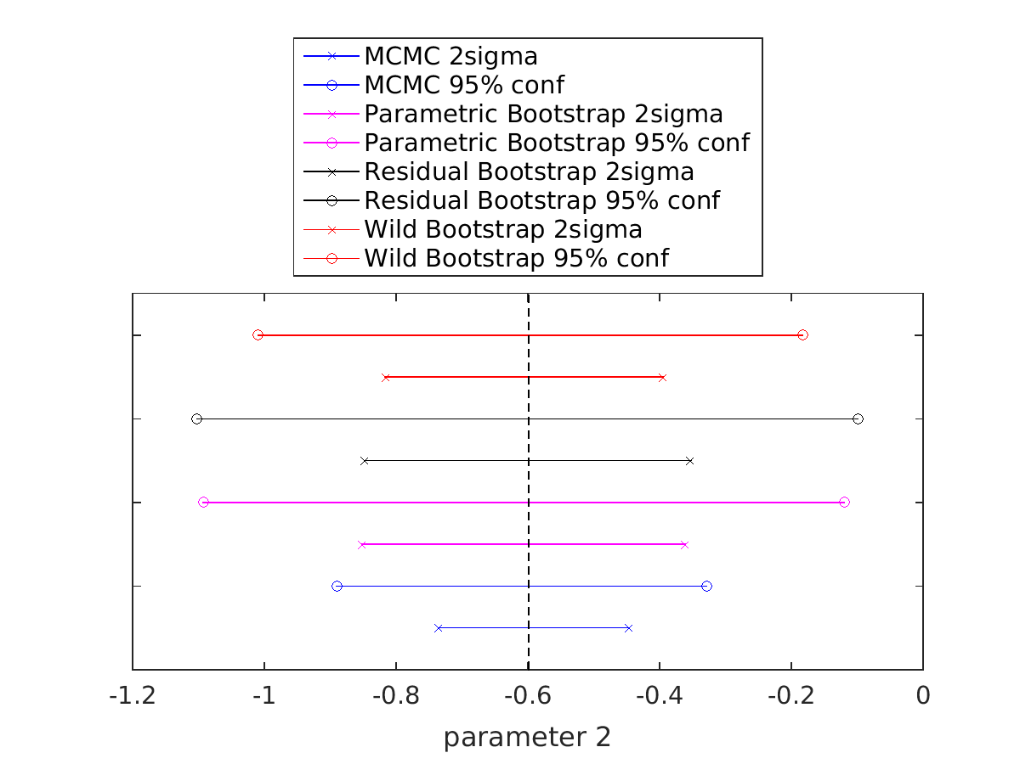

Core task 5: Uncertainty - Different models
Confidence intervals on cubic model coefficients
Couch position 5
<number>

Slide 34



Core task 4 - Motion Models Evaluation
Visual Assessment
Linear
Quadratic
Cubic
Couch 2, volume 5, slice 60
<number>

Slide 35



Core task 4 - Motion Models Evaluation
Visual Assessment
Linear
Quadratic
Cubic
Couch 4, volume 8, slice 37
<number>

Slide 36





Core task 4 - Motion Models Evaluation
Deformation Field Error - mean error
<number>

Slide 37
Core task 4 - Motion Models Evaluation
Deformation Field Error - mean error
<number>

Slide 38
Core task 4 - Motion Models Evaluation
Deformation Field Error - mean error
<number>

Slide 39
Core task 4 - Motion Models Evaluation
Deformation Field Error - mean error
<number>

Slide 40
Core task 4 - Motion Models Evaluation
Deformation Field Error - mean error
<number>

Slide 41
Core task 4 - Motion Models Evaluation
Deformation Field Error - mean error
<number>

Slide 42





Core task 4 - Motion Models Evaluation
Deformation Field Error - standard deviation
<number>

Slide 43
Core task 4 - Motion Models Evaluation
Deformation Field Error - standard deviation
<number>

Slide 44
Core task 4 - Motion Models Evaluation
Deformation Field Error - standard deviation
<number>

Slide 45
Core task 4 - Motion Models Evaluation
Deformation Field Error - standard deviation
<number>

Slide 46
Core task 4 - Motion Models Evaluation
Deformation Field Error - standard deviation
<number>

Slide 47
Core task 4 - Motion Models Evaluation
Deformation Field Error - standard deviation
<number>

Slide 48





Core task 4 - Motion Models Evaluation
Landmarks Error
<number>

Slide 49
Core task 4 - Motion Models Evaluation
Landmark Error
<number>

Slide 50
Core task 4 - Motion Models Evaluation
Landmark Error
<number>

Slide 51
Core task 4 - Motion Models Evaluation
Landmark Error
<number>

Slide 52
Core task 4 - Motion Models Evaluation
Landmark Error
<number>

Slide 53
Core task 4 - Motion Models Evaluation
Landmark Error
<number>

Slide 54

Core task 4 - Motion Models Evaluation
Information Criterias: AIC/BIC
<number>

Slide 55
?
Thanks!
<number>

